Slide 1


Tourism Monitoring System for Bolinao
DANILYN V. BANOGON
JESTER EINSTEIN C. IBASAN
JERHOME T. REANTASO
JASMINE B. ZINAMPAN

Slide 2


RATIONALE
Bolinao tourism must also transition to newer technology in order to:
(1) continue to monitor the destinations;
(2) regulate heavy traffic and policy for desperate measures; and
(3) mitigate the impact of overtourism.

Slide 3

RATIONALE
Tourism Monitoring System is a dynamic and responsive system, and it addresses the challenges of managing the records, missing records due to human errors.

Slide 4

OBJECTIVES OF THE STUDY
Identify the existing process and monitoring techniques of Bolinao’s Tourism.
Identify the problems encountered within the existing process of Bolinao Tourism Office.
Devise features to be integrated in the proposed Tourism Monitoring System; and
Determine the acceptability level of the developed system.

Slide 5



IMPORTANCE OF THE STUDY
TOURISM OFFICE OF BOLINAO
TOURISTS
THE FUTURE PROPONENTS
OWNERS OF REGISTERED ESTABLISHMENTS
THE PROPONENTS

Slide 6


SCOPE AND DELIMITATION of THE STUDY
Bolinao is chosen locale of the study
Tourist Account & Activity Management
Real-time Monitoring with Visual Map
Tourist Data Collection
List of Registered Establishments
NO Financial Transactions(e.g. Payments for Booking)
Maintenance of the web-system after deployment is not included in the study.

Slide 7
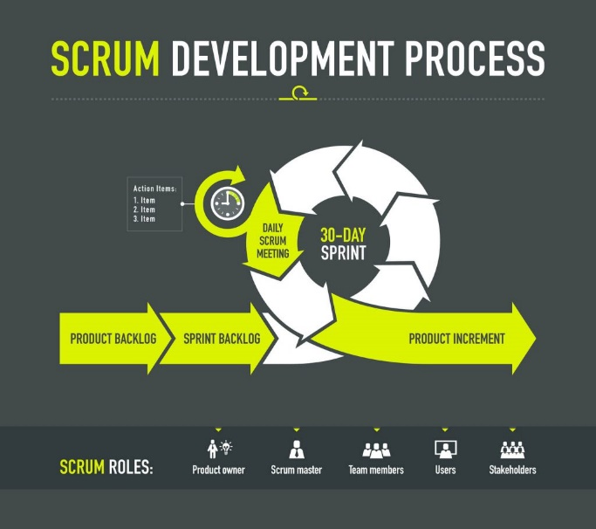
METHODOLOGY
Adaptable, Fast, Flexible, and Effective
Continuous Improvement
Product Backlogs & Sprints
Open Communication
Shared Responsibility

Slide 8

METHODOLOGY
FAST
CREATIVE AND INNOVATIVE
IMPROVED PRODUCT QUALITY
STAKEHOLDER SATISFACTION

Slide 9

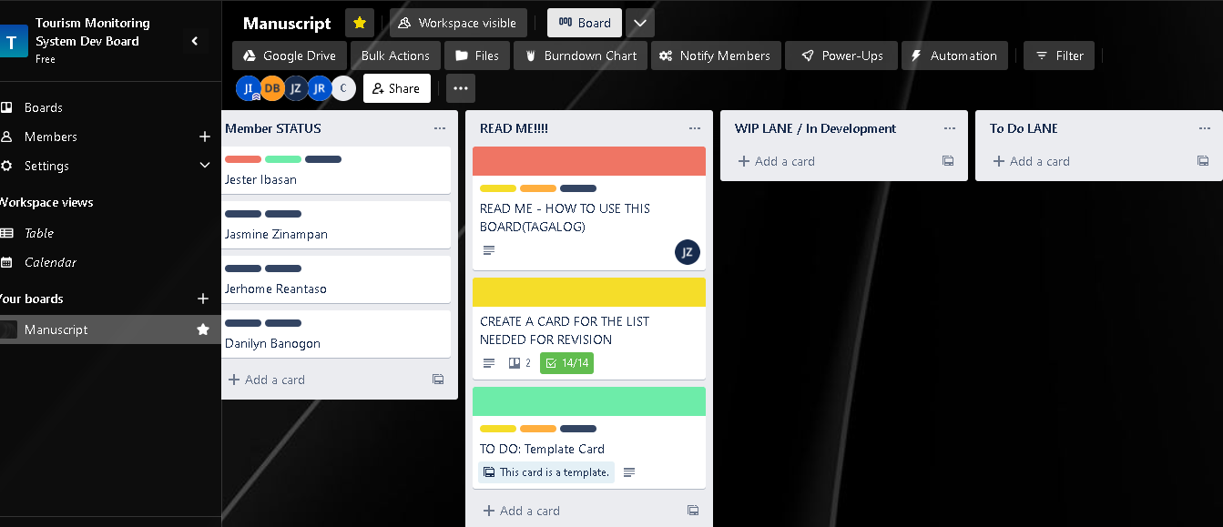
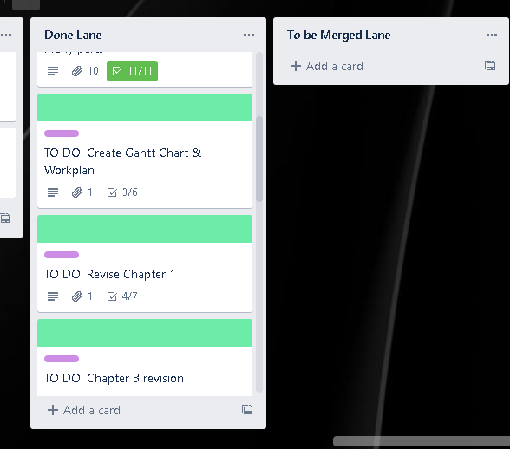


SCRUM PHASES
ASSIGNING OF ROLES
INITIATION

Slide 10

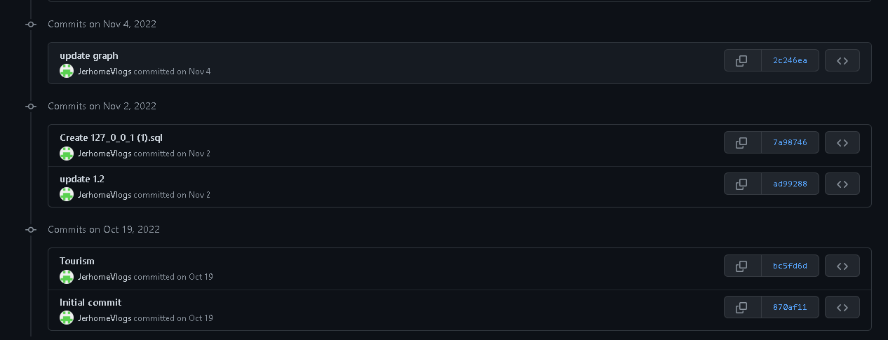

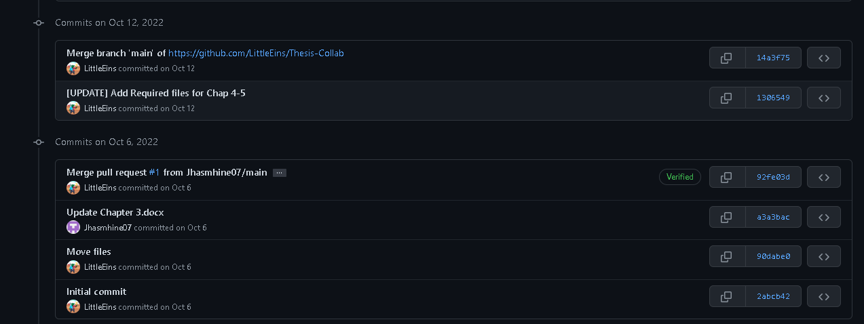
SCRUM PHASES
PLANNING AND ESTIMATION
System Repo
Document Repo

Slide 11
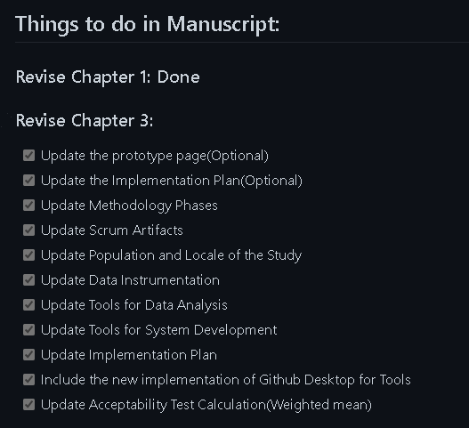
SCRUM PHASES
PLANNING AND ESTIMATION

Slide 12
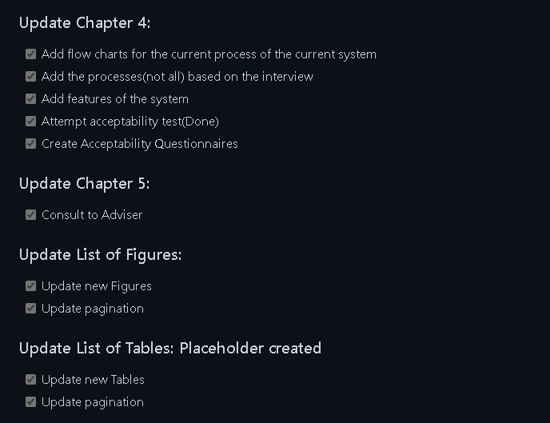
SCRUM PHASES
PLANNING AND ESTIMATION

Slide 13
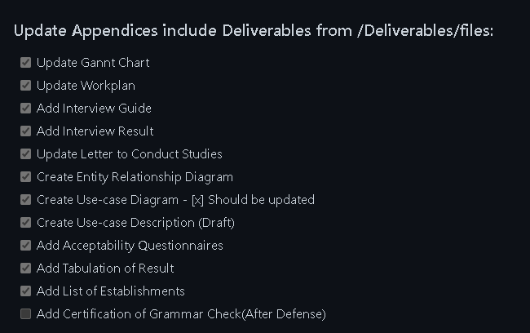
SCRUM PHASES
PLANNING AND ESTIMATION

Slide 14
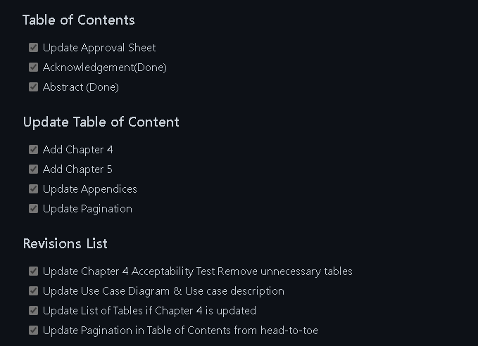
SCRUM PHASES
PLANNING AND ESTIMATION

Slide 15
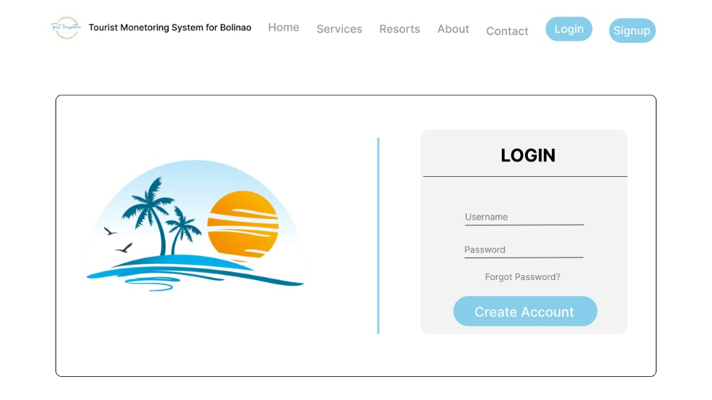
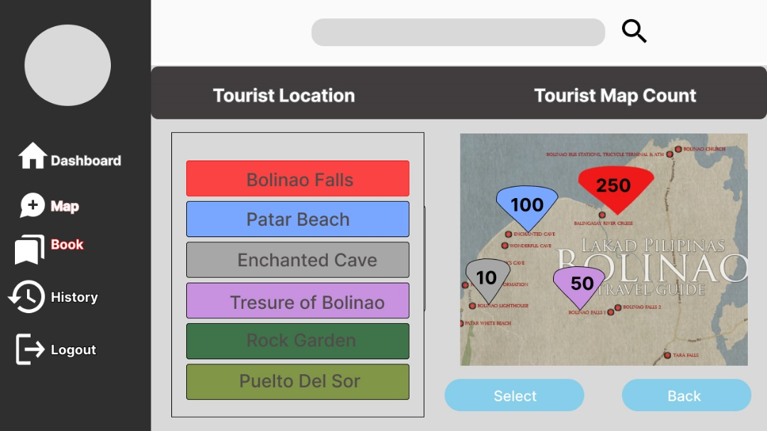
SCRUM PHASES
PROTOTYPE DESIGN
PLANNING AND ESTIMATION

Slide 16



SCRUM PHASES
VISUAL STUDIO CODE
LARAVEL PHP FRAMEWORK
XAMPP
PLANNING AND ESTIMATION

Slide 17
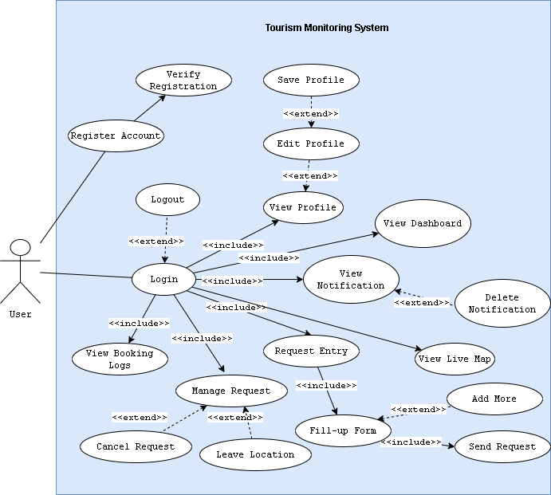


SCRUM PHASES
FLOWCHARTS
USE-CASE DIAGRAM
ER DIAGRAM
FIGMA
DRAW.IO
PLANNING AND ESTIMATION

Slide 18
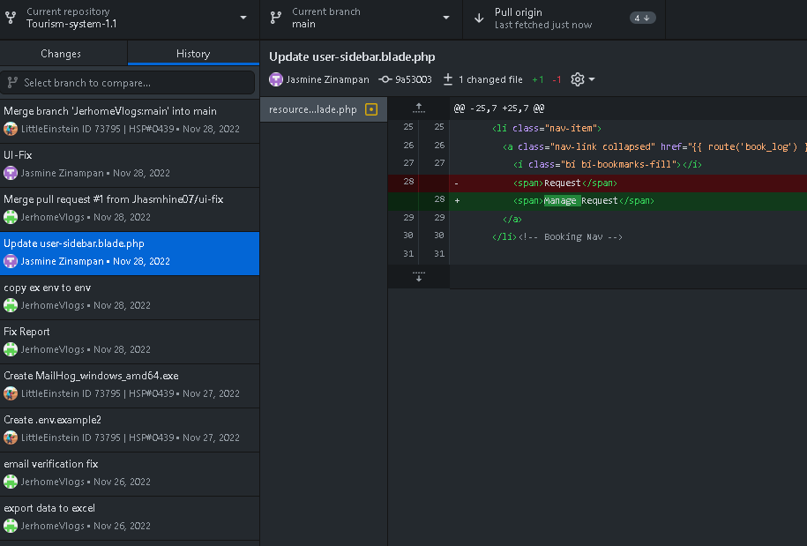


SCRUM PHASES
FORKED REPO
IMPLEMENTATION
PUSH AND PULL OF SPRINTS
GITHUB DESKTOP

Slide 19
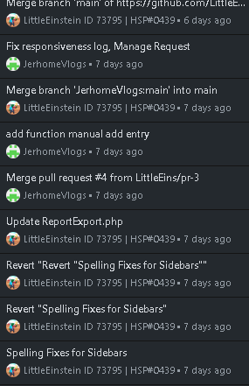

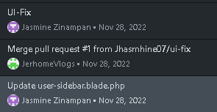


SCRUM PHASES
SCRUM MEETING
RELEASING
BUG-FIXES
GITHUB DESKTOP

Slide 20
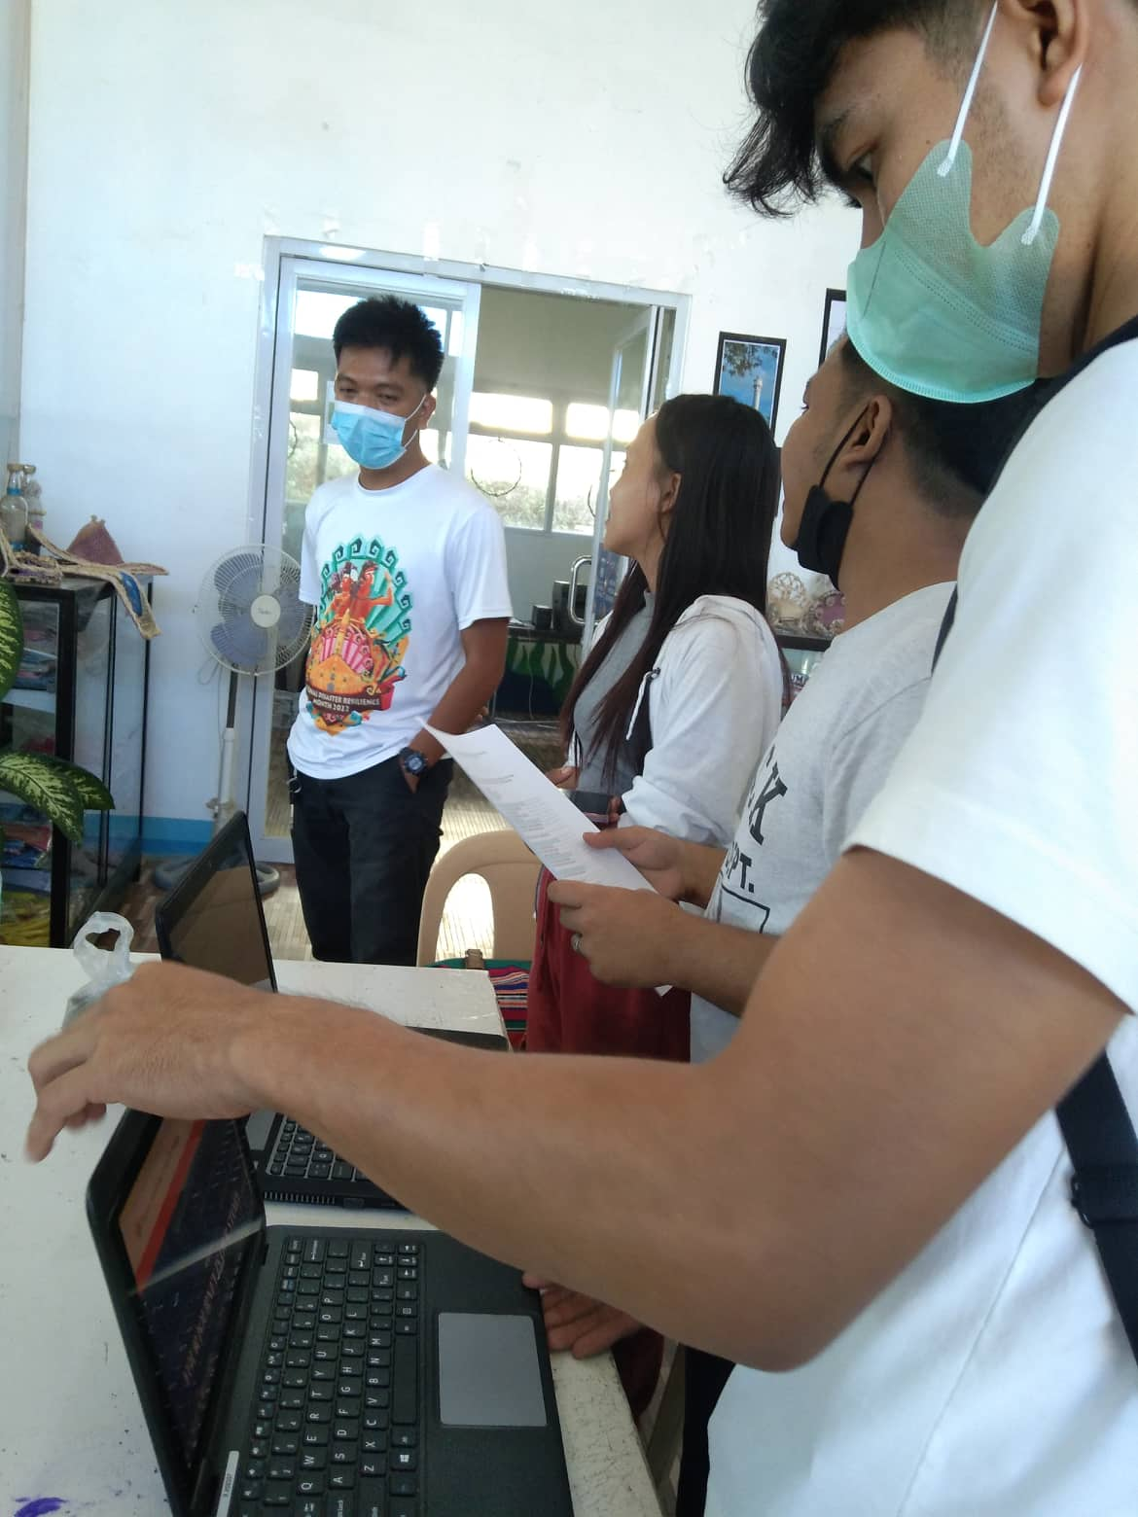
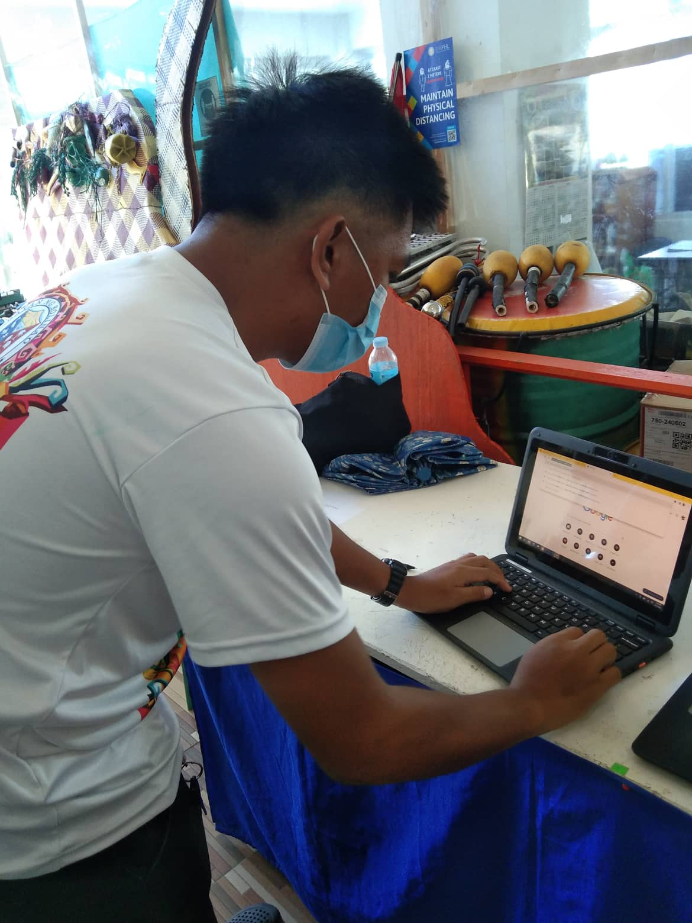

SCRUM PHASES
DEMO & TESTING
RELEASING

Slide 21
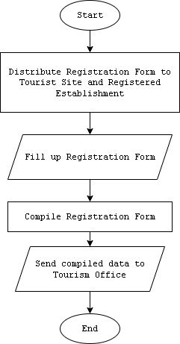
RESULT & DISCUSSION
REGISTRATION OF TOURIST DATA

Slide 22
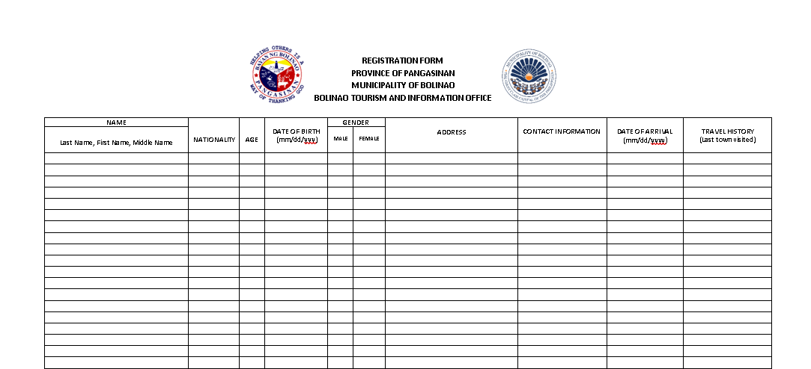
RESULT & DISCUSSION
REGISTRATION FORM

Slide 23
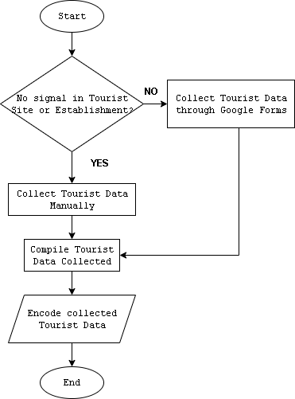
RESULT & DISCUSSION
MANUAL TOURISTS’ DATA COLLECTION

Slide 24
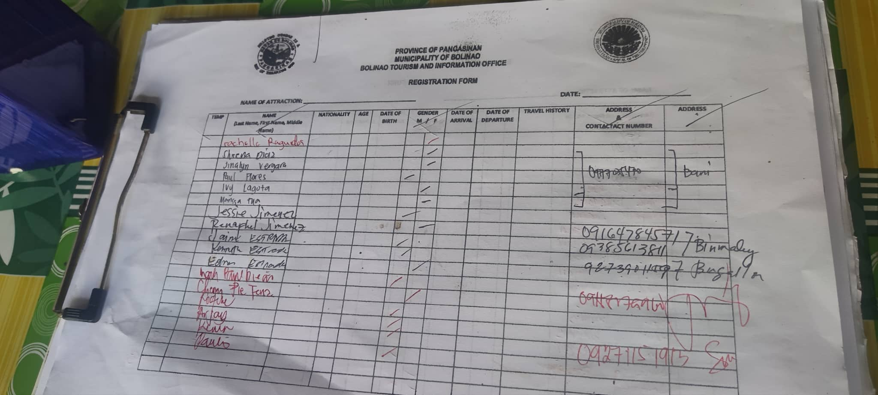
RESULT & DISCUSSION
MANUAL PROCESS OF COLLECTING TOURISTS’ DATA

Slide 25
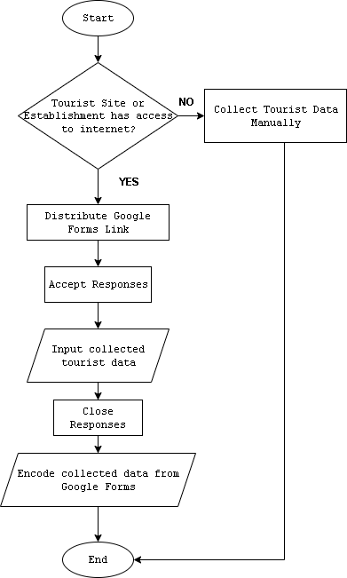
RESULT & DISCUSSION
COLLECTING TOURISTS’ DATA VIA GOOGLE FORMS

Slide 26

RESULT & DISCUSSION
GOOGLE FORMS IF THERE IS NO NETWORK SIGNAL

Slide 27
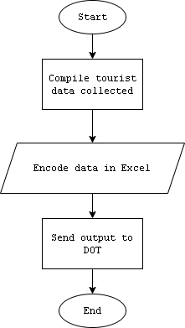

RESULT & DISCUSSION
ENCODING OF COMPILED TOURISTS’ DATA
SENDING DATA TO DOT

Slide 28






DIFFICULTIES ENCOUNTERED IN TOURISM OFFICE
Limited network signals in other sites and establishments.
Time-consuming collection of data.
Inconvenience to guests.

Slide 29
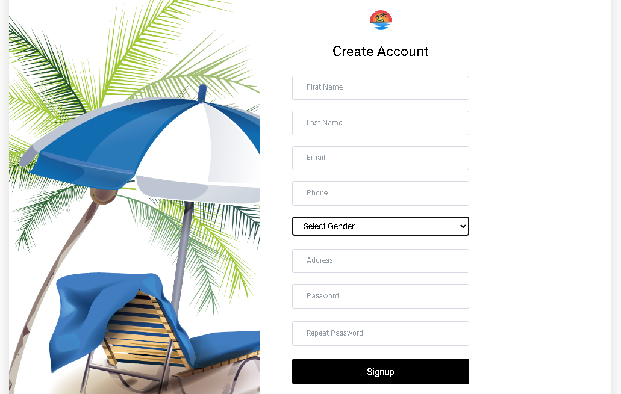
RESULT & DISCUSSION
FEATURES OF THE SYSTEM
REGISTRATION

Slide 30
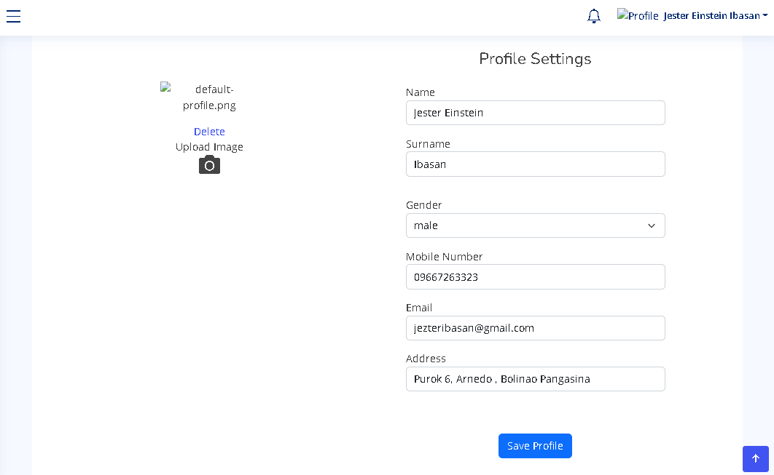
RESULT & DISCUSSION
FEATURES OF THE SYSTEM
USER PROFILE

Slide 31
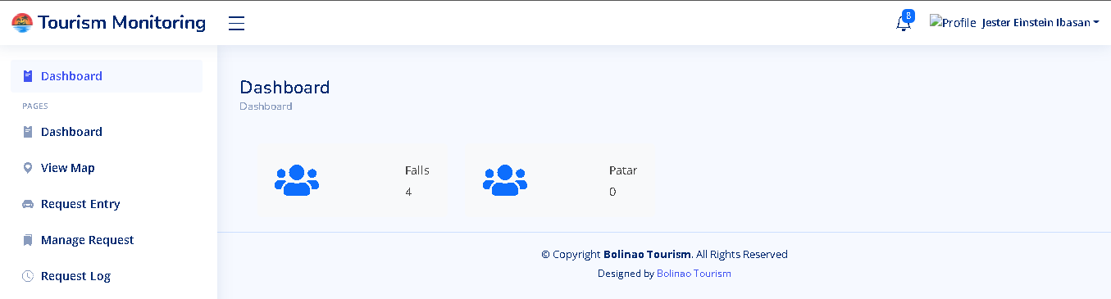
RESULT & DISCUSSION
FEATURES OF THE SYSTEM
DASHBOARD

Slide 32
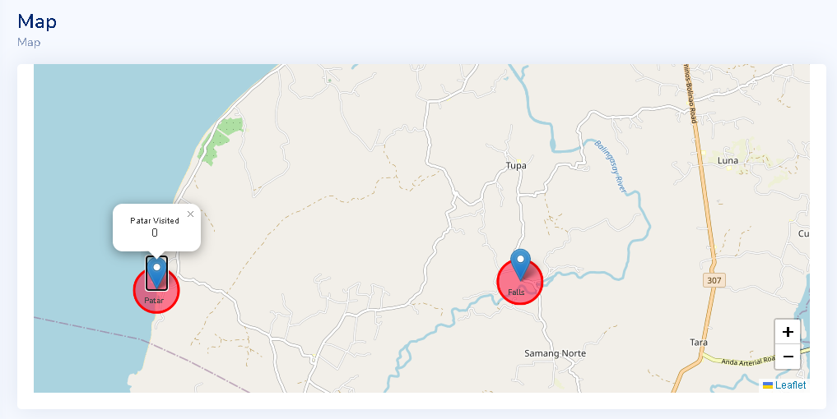
RESULT & DISCUSSION
FEATURES OF THE SYSTEM
LIVE MAP COUNTER
Sprint 1

Slide 33
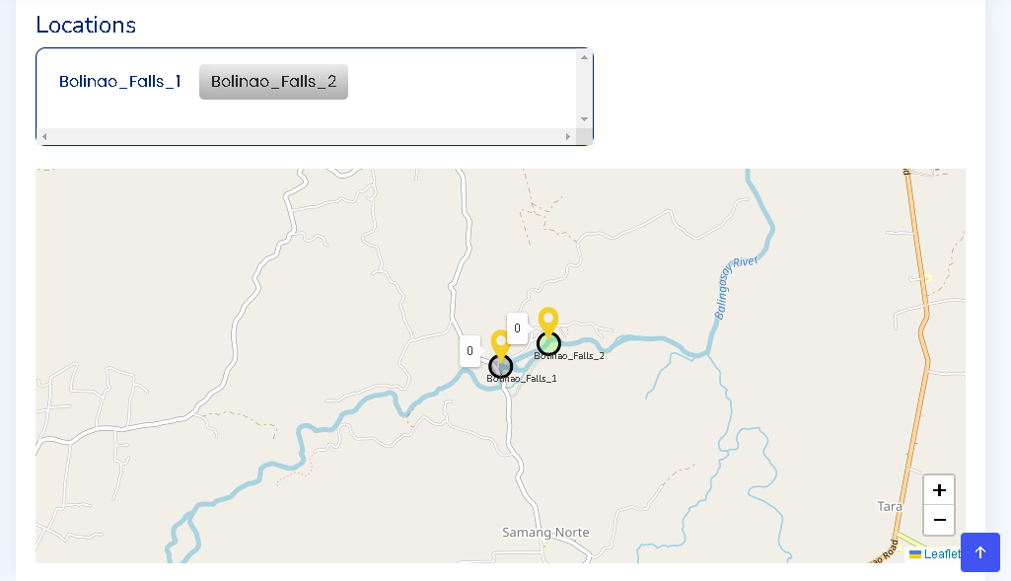
RESULT & DISCUSSION
FEATURES OF THE SYSTEM
LIVE MAP COUNTER
Sprint 1I

Slide 34
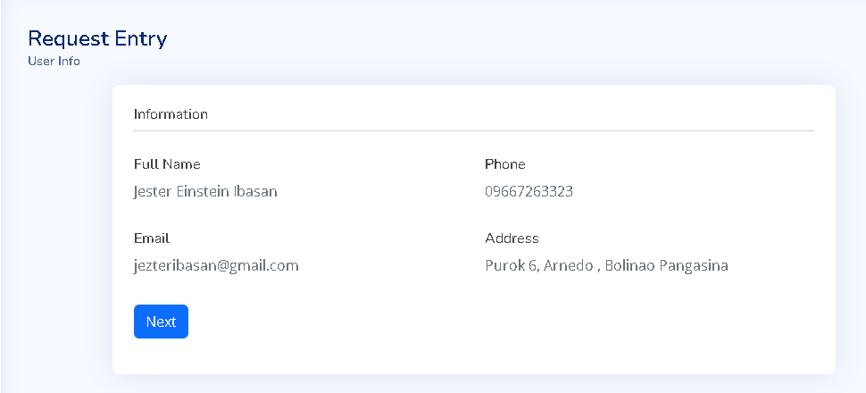
RESULT & DISCUSSION
FEATURES OF THE SYSTEM
REQUEST ENTRY - 1

Slide 35
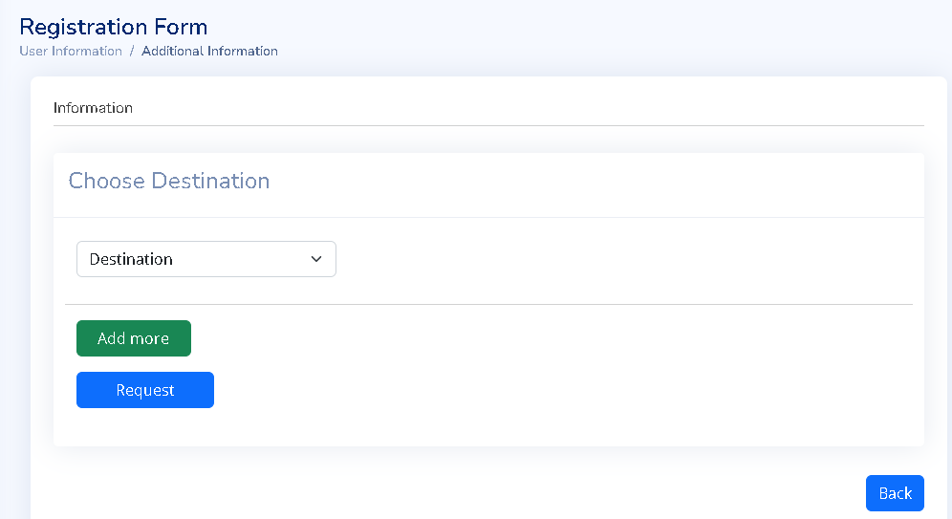
RESULT & DISCUSSION
FEATURES OF THE SYSTEM
REQUEST ENTRY - II

Slide 36
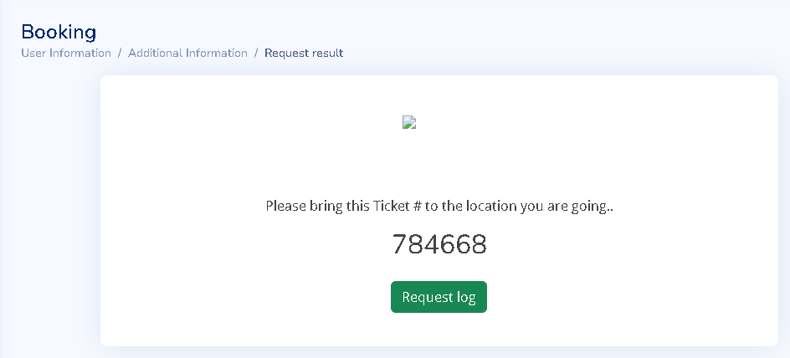
RESULT & DISCUSSION
FEATURES OF THE SYSTEM
REQUEST ENTRY - III

Slide 37
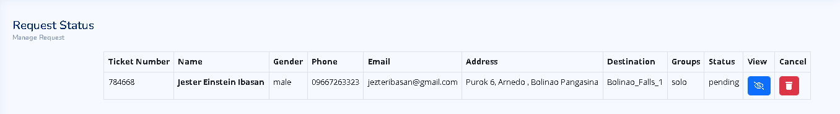
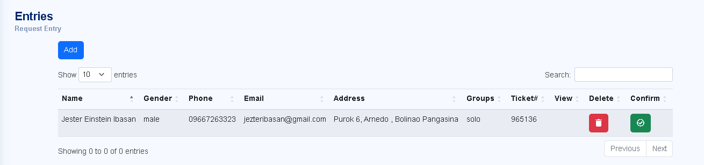
RESULT & DISCUSSION
FEATURES OF THE SYSTEM
MANAGE REQUEST – USER
MANAGE REQUEST - STAFF

Slide 38
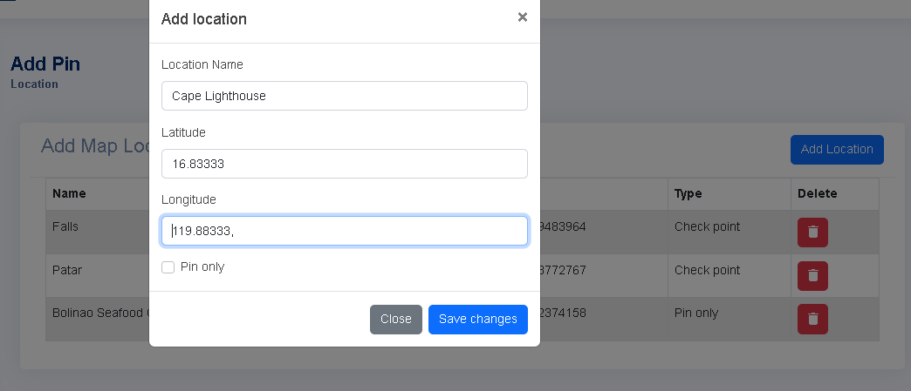
RESULT & DISCUSSION
FEATURES OF THE SYSTEM
ADD SITE LOCATION – Sprint 1

Slide 39
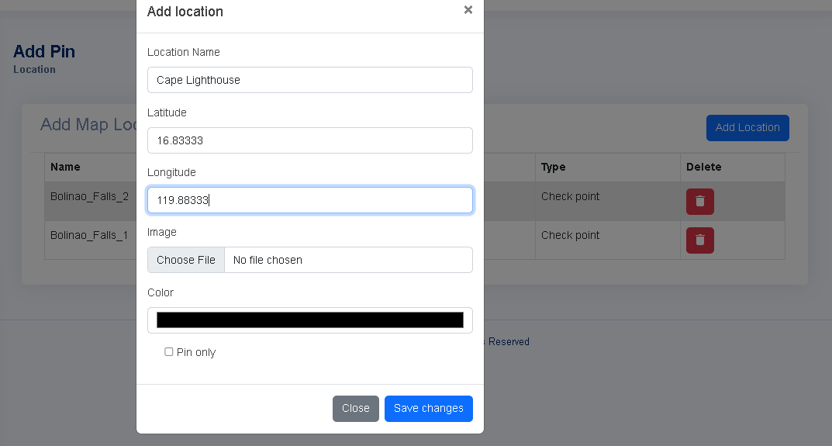
RESULT & DISCUSSION
FEATURES OF THE SYSTEM
ADD SITE LOCATION – Sprint II

Slide 40
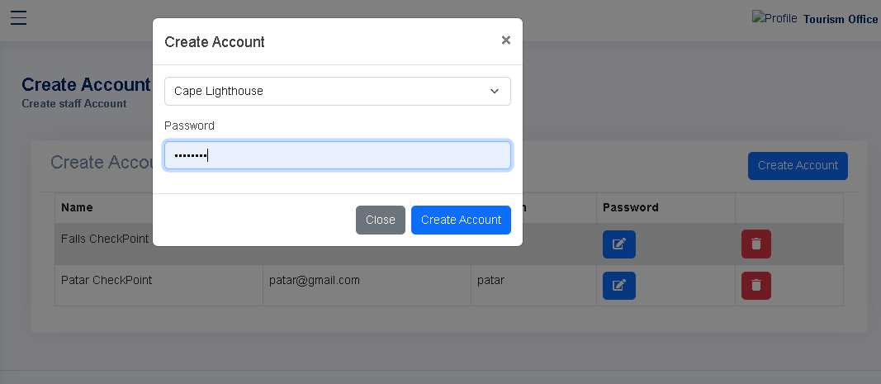
RESULT & DISCUSSION
FEATURES OF THE SYSTEM
STAFF ACCOUNT CREATION

Slide 41
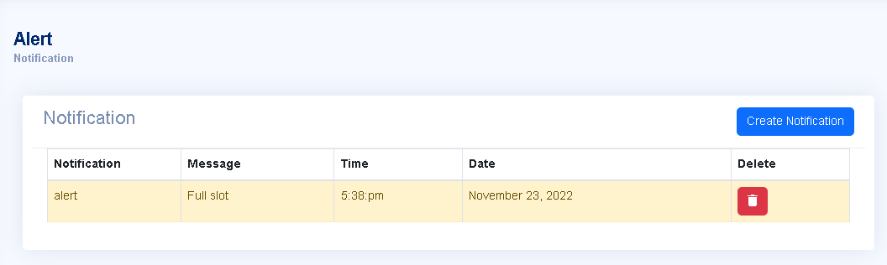
RESULT & DISCUSSION
FEATURES OF THE SYSTEM
NOTIFICATIONS

Slide 42
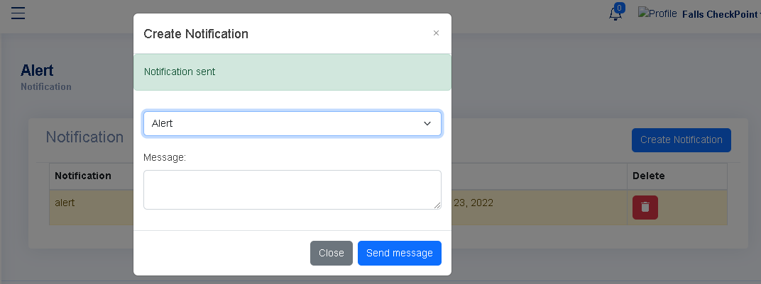
RESULT & DISCUSSION
FEATURES OF THE SYSTEM
NOTIFICATIONS - CREATE

Slide 43
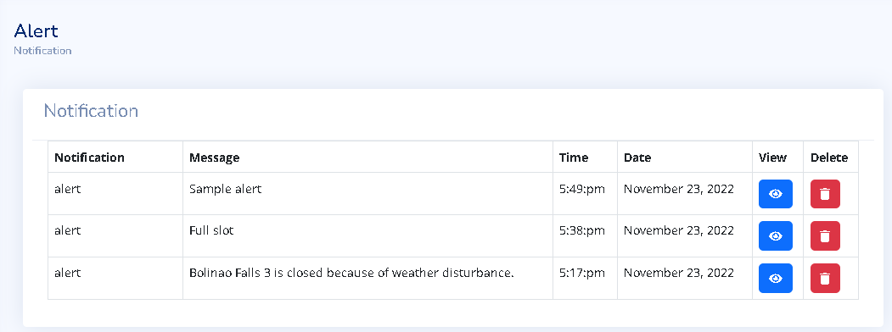
RESULT & DISCUSSION
FEATURES OF THE SYSTEM
NOTIFICATIONS - VIEW

Slide 44
RESULT & DISCUSSION
ACCEPTABILITY TEST
LIKERT SCALE
Scale | Range | Descriptive Rating
4 | 3.26 – 4.00 | Acceptable
3 | 2.51 – 3.25 | Slightly Acceptable
2 | 1.76 – 2.50 | Slightly Unacceptable
1 | 1.00 – 1.75 | Unacceptable

Slide 45
RESULT & DISCUSSION
ACCEPTABILITY TEST
FUNCTIONALITY.
FUNCTIONALITY | Mean | Description
1. Suitability – The functions of the system are appropriate. | 3.9 | Acceptable
2. Accuracy – The system’s results are accurate. | 3.78 | Acceptable
3. Compliance – It adheres to existing standards and policies. | 3.74 | Acceptable
4. Security – It prevents unauthorized access. | 3.76 | Acceptable
Weighted Mean | 3.8 | Acceptable

Slide 46
RESULT & DISCUSSION
ACCEPTABILITY TEST
RELIABILITY.
RELIABILITY | Mean | Description
1. Maturity – There is a minimum frequency of software faults/failures. | 3.56 | Acceptable
2. Fault Tolerance – The system can handle system errors. | 3.72 | Acceptable
3. Recoverability – System’s performance is re-establishing from failure. | 3.76 | Acceptable
Weighted Mean | 3.68 | Acceptable

Slide 47
RESULT & DISCUSSION
ACCEPTABILITY TEST
USABILITY.
USABILITY | Mean | Description
1.Understandability – Concepts are easily recognized. | 3.87 | Acceptable
2. Learnability – The system’s functions are easy to learn | 3.76 | Acceptable
3. Operability – The system is easy to use or operate. | 3.83 | Acceptable
Weighted Mean | 3.82 | Acceptable

Slide 48
RESULT & DISCUSSION
ACCEPTABILITY TEST
EFFICIENCY.
EFFICIENCY | Mean | Description
1. Time Behavior – There is a fast response time in the system. | 3.85 | Acceptable
2. Resource Behavior – Resources used for system performance are accessible. | 3.81 | Acceptable
Weighted Mean | 3.83 | Acceptable

Slide 49
RESULT & DISCUSSION
ACCEPTABILITY TEST
MAINTAINABILITY.
MAINTANABILITY | Mean | Description
1. Analyzability – There is less effort in identifying system failure causes. | 3.78 | Acceptable
2. Changeability – Effort in modifying the system | 3.74 | Acceptable
3. Stability – Sensitivity to modification | 3.67 | Acceptable
Weighted Mean | 3.73 | Acceptable

Slide 50
RESULT & DISCUSSION
ACCEPTABILITY TEST
PORTABILITY.
PORTABILITY | Mean | Description
Adaptability – Specification changes are done easily. | 3.74 | Acceptable
Installability – There is effortless process of installing the system. | 3.87 | Acceptable
Conformance – System is compliant to portability standards. | 3.85 | Acceptable
Weighted Mean | 3.82 | Acceptable

Slide 51
RESULT & DISCUSSION
ACCEPTABILITY TEST
OWM OF RESPONDENTS.
AREA | Average Weighted Mean | Description
Functionality | 3.8 | Acceptable
2. Reliability | 3.68 | Acceptable
3. Usability | 3.82 | Acceptable
4. Efficiency | 3.86 | Acceptable
5. Maintainability | 3.73 | Acceptable
6. Portability | 3.82 | Acceptable
Overall Weighted Mean | 3.78 | Acceptable

Slide 52
CONCLUSION
The existing process of the Tourism Office was collection of tourist data through distribution of registration forms in the tourist sites and establishments. Monitoring Techniques observed is by collection of tourists’ data through (a) manual collection; and (b) Google Forms which is being processed by assigned statistician.

Slide 53
CONCLUSION
The tourism office encountered difficulties in collecting data because of how network signals are being interrupted specifically to remote areas of Bolinao that has tourist site or establishment. This affects the time to collect, encode, and generate reports in the tourism office. Guests visiting the locale is having inconvenience because of how limited the information are in a status of a destination.

Slide 54
CONCLUSION
The features of the proposed system are
(a) Register account where OTP is implemented,
(b) User Profile Setting for users to edit profile information for booking,
(c) Dashboard where users will see the live counts of people who booked in a destination,
(d) Live Map Counter to see the map of Bolinao with pins and live counts,
(e) Booking which allows user to request entry to their preferred destination with ticket number generation,
(f) Manage Request where users will be able to cancel, leave destination, and see status of the booking,
(g) Staff Account Creation to create staff accounts per destination registered in the system; and
(h) Notification that notifies users for alerts or updates from a destination .

Slide 55
CONCLUSION
Based on the results of the proponent’s survey, the weighted mean in terms of functionality, reliability, usability, efficiency, maintenance, and portability is 3.78 which reflects as Acceptable; therefore, the developed web-based system can now be adopted for implementation by the Tourism Office of Bolinao.

Slide 56
RECOMMENDATIONS
To use the web-application, the tourism office will be given hands-on training.

Slide 57
RECOMMENDATIONS
It is recommended to train the user of the staff accounts of the location in using the web-application specially in cases that there is network signal interruption.

Slide 58
RECOMMENDATIONS
To effectively use the web-application, the tourism office should secure their server and domain to avoid network attacks such as DDoS.

Slide 59
RECOMMENDATIONS
The web-application should be updated through GitHub after implementation. Code collaborators should use branches to create PRs for easy compiling of fixes or updates.

Slide 60

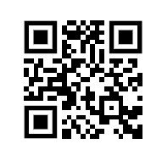
DEMONSTRATION OF SYSTEM
Connect to the Wi-Fi Network: S0uL
Password: S0uLEins
go to your browser and enter this URL:
192.168.254.100:8000
Connect to: S0uL and go to your browser and enter this URL 192.168.254.100:8000 or Please use your phone to scan this QR Code.

Slide 61

THANK YOU!

